Slide 1

Problem Statement 2
Integrated common services for common people

Slide 2
Unique idea Brief
Architecture
01
04
Features offered
Technologies used
02
05
Process flow
Our Team
03
06
Solution for problem statement
Diagram
Specified for solution
which have used
How it works
Team members with contribution
07
Conclusion

Slide 3

Spark innovation presents “GConn”
GConn is website developed by us for common people for common services “GConn” is name derived from Gram connect that means connecting people in a particular region.

Slide 4
01
Fragmented Service Access:
Problem: Users often struggle to find a centralized platform that offers a variety of essential services such as education, finance, transportation, and healthcare. This fragmentation forces users to visit multiple websites or applications, leading to inefficiencies and a poor user experience.
Solution: GConn integrates these diverse services into a single, user-friendly platform, providing a one-stop solution for users to access all their essential services conveniently.

Slide 5
01
Complex and Unintuitive Interfaces:
Problem: Many existing service platforms have complicated and unintuitive interfaces, making it difficult for users to navigate and find the services they need. This can be especially challenging for users who are not tech-savvy.
Solution: GConn features a clean, intuitive, and easy-to-navigate interface, ensuring users can quickly find and access the services they need without confusion or frustration.

Slide 6
01
Difficulty in Accessing and Managing Services on the Go:
Problem: Users need a platform that they can access from anywhere, on any device, to manage their services efficiently, especially for on-the-go tasks like booking rides or scheduling appointments.
Solution: GConn is accessible on multiple devices, ensuring users can manage their services anytime, anywhere. The responsive design adapts to different screen sizes, providing a seamless experience across desktops, tablets, and smartphones.

Slide 7
02
Features of Project
GConn provides a centralized platform offering a variety of essential services.
Seamless integration of education, finance, transportation, and healthcare services.
User-friendly interface for quick and easy access to required services.
Secure and reliable connections to verified service providers.

Slide 8
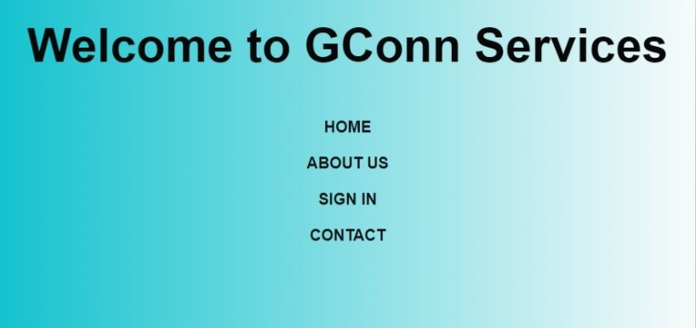
03
Process flow
Service Selection: Users browse and select the desired service category.
Form Submission: Users fill out and submit relevant forms.
Service Confirmation: Users receive confirmation and further instructions.
Feedback: Users provide feedback to improve service quality.

Slide 9
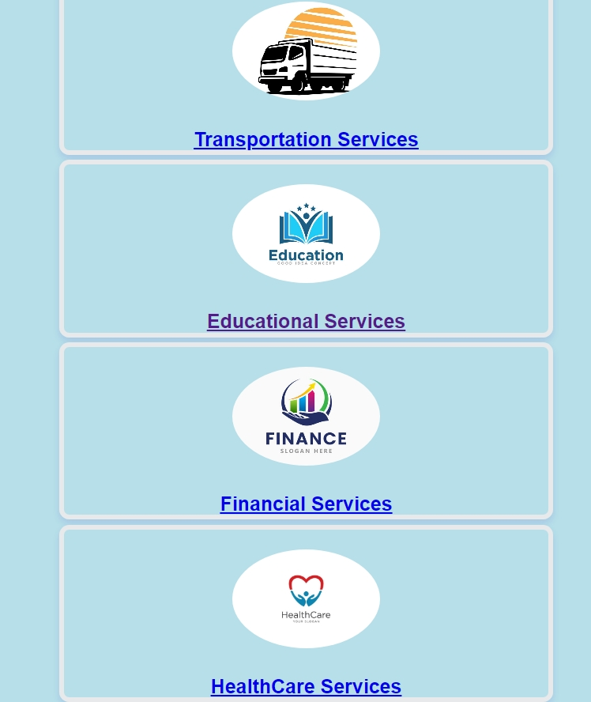
Now selected a service
Users browse and select the desired service category.

Slide 10
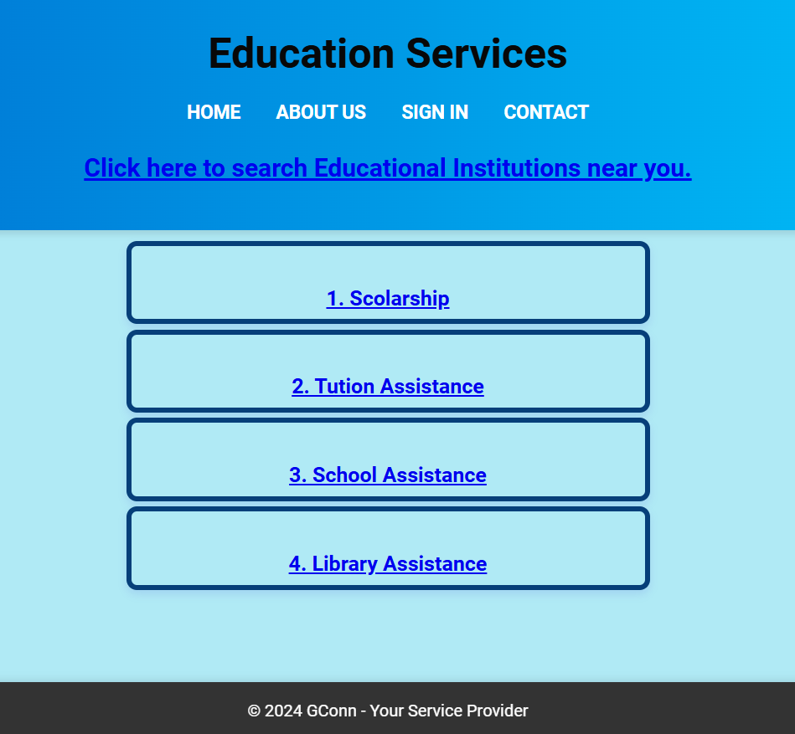
Subpage for service
User can select what they want for which they are looking

Slide 11
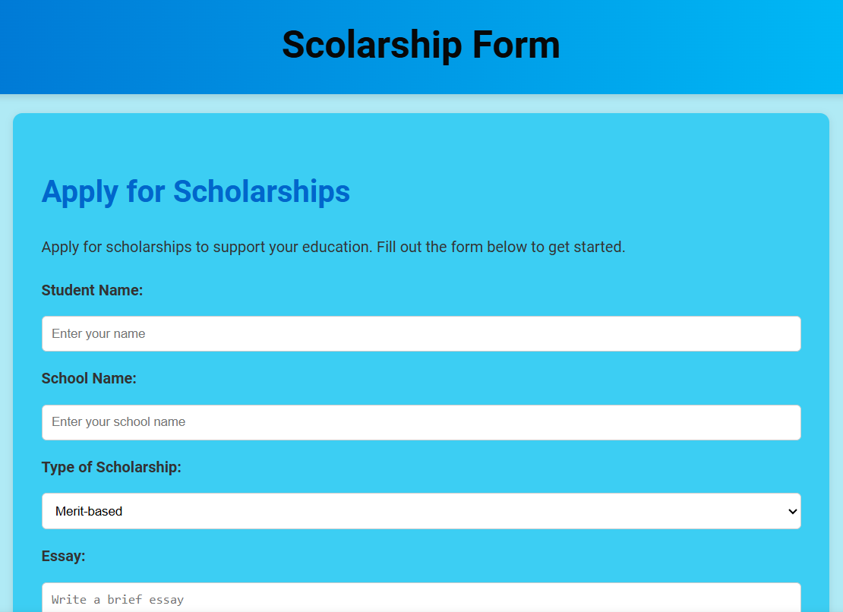
Example service
Form filling
Lets see how education service for scholarship forms

Slide 12


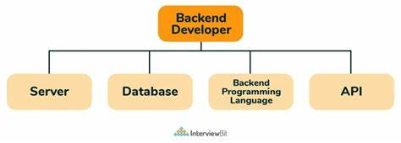

04 Architecture
Front-end
Back-end
Deployment
HTML, CSS, JS
Node.js
GitHub

Slide 13
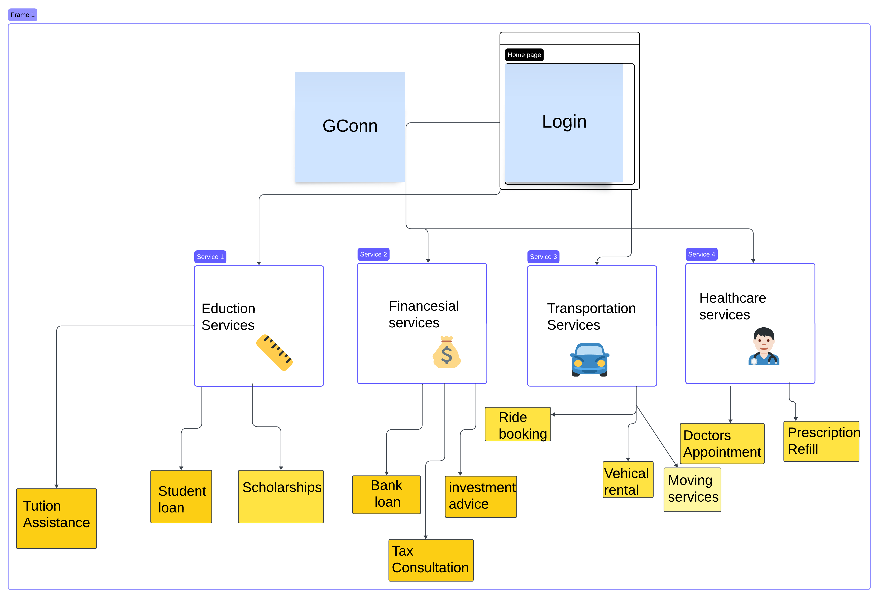
Flow diagram

Slide 14

Team members
Member 1
Member 3
Member 4
Member 2
Vaishnavi
Roopner
(leader)
Shweta Wattamwar
(Reasarch)
Anushka
Ingole
(Developer)
Siddhi
Deshpande
(Development)

Slide 15
Conclusion
GConn consolidates essential services in education, finance, transportation, and healthcare into a single, user-friendly platform.
Robust frontend and backend integration ensures a seamless user experience and reliable service delivery.
Utilizes modern technologies such as Node.js, Express.js, and MongoDB for scalability and efficiency.
Deployment on GitHub Pages simplifies access and maintenance.
Ongoing testing and user feedback will drive continuous improvements and feature enhancements to meet evolving user needs.

Slide 16
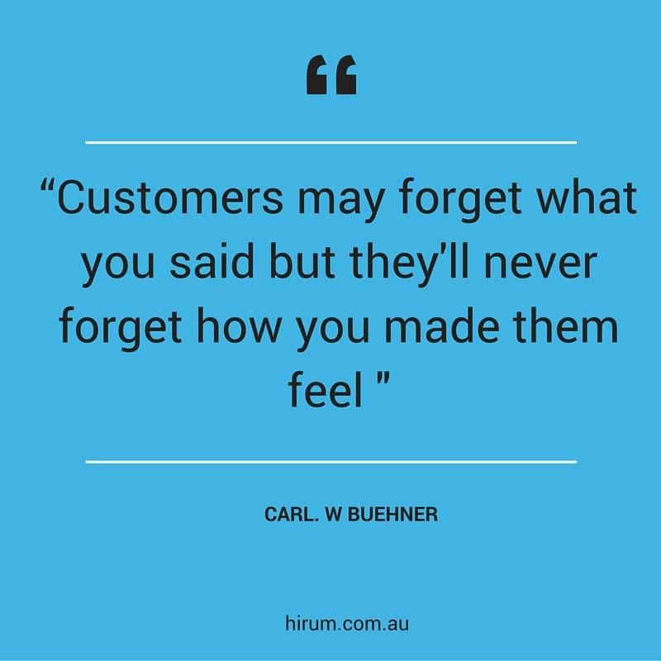
Awesome words

